Slide 1
MARKET BASKET ANALYSIS

Slide 2


TEAM MEMBERS
A
K.B.AJAY KUMAR
D.JAGADEESAN

Slide 3
INTRODUCTION
Market Basket Analysis is one of the key techniques used by large retailers to uncover associations between items.
It works by looking for combinations of items that occur together frequently in transactions.
To put it another way, it allows retailers to identify relationships between the items that people buy.

Slide 4
ABSTRACT
Market Basket Analysis is one of the key techniques used by large retailers to uncover associations between items.
It works by looking for combinations of items that occur together frequently in transactions. To put it another way, it allows retailers to identify relationships between the items that people buy. Association Rules are widely used to analyze retail basket or transaction data, and are intended to identify strong rules discovered in transaction data using measures of interestingness, based on the concept of strong rules.
The outcome of this type of technique is, in simple terms, a set of rules that can be understood as “if this, then that”. Association rule mining finds interesting associations and relationships among large sets of data items. This rule shows how frequently a itemset occurs in a transaction. The project is developed by applying and utilizing the Association rules on the data item list.

Slide 5
ASSOCIATION RULE
An implication expression of the form X -> Y, where X and Y are any 2 item sets.
Example., {Milk, Diaper}->{Bread}

Slide 6
RULE EVALUATION METRICS

Slide 7
Support
The number of transactions that include items in the {X} and {Y} parts of the rule as a percentage of the total number of transaction. It is a measure of how frequently the collection of items occur together as a percentage of all transactions.
Confidence
It is the ratio of the no of transactions that includes all items in {B} as well as the no of transactions that includes all items in {A} to the no of transactions that includes all items in {A}.

Slide 8
Lift(I)
The lift of the rule X=>Y is the confidence of the rule divided by the expected confidence, assuming that the item sets X and Y are independent of each other. The expected confidence is the confidence divided by the frequency of {Y}.
Lift(X=>Y) = Conf(X=>Y)/Supp(Y)
Lift value near 1 indicates X and Y almost often appear together as expected, greater than 1 means they appear together more than expected and less than 1 means they appear less than expected. Greater lift values indicate stronger association.

Slide 9
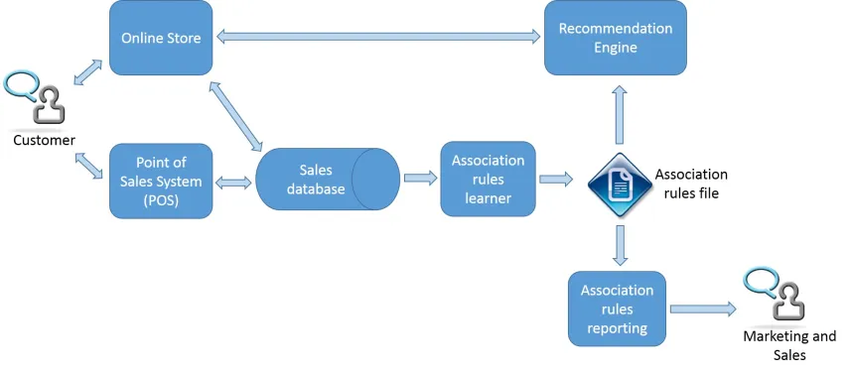
SYSTEM ARCHITECTURE

Slide 10
LITERATURE SURVEY

Slide 11
Market basket analysis using artificial neural network
Abstract:
Market basket analysis is based upon the identification and analysis of purchasing patterns of the customers.
The problem with market basket analysis is the varying needs of the customers with respect to seasons and time and so we need to perform it time and again. Another problem that arises while doing market basket analysis is with Apriori algorithm in which we need to find candidate sets and frequent item-sets time and again.
In this paper, we are suggesting the use of artificial neural network technique to overcome these problems. We have used single layer feed-forward partially connected neural network technique for this purpose.

Slide 12
Market Basket Analysis Based on Text Segmentation and Association Rule Mining
Abstract:
Market basket analysis helps to provide scientific decision support for retail market by mining association rules among items people purchased together.
In this paper, we propose an innovative market basket analysis method by mining association rules on the items' internal characteristics which are obtained by using automatic words segmentation technology.
The method has been applied to a dynamic dishes recommend system and validated by the experimental results.

Slide 13
K-Means Clustering-Based Market Basket Analysis: U.K. Online E-Commerce Retailer
Abstract:
Market basket analysis provides retailers a significant edge when they go to the market. This is especially as traditional marketing costs are increasing each year, while generating lesser return on investment.
A UK-domiciled online retailer involved in selling gift products to mainly wholesaler clientele, was looking to create recommendations for bundling sales to promote cross-selling and/or upselling opportunities.
Differentiated bundling strategies can have significant effect on product sales, while designed in response to consumer interest. However, segmentation applied to augment MBA is less common in literature, with limited studies applied on online retailers. The key objective of this research is to (i) add to the literature on segmentation-backed MBA analysis on online retailers, and (ii) understand how different products from an online retailer interrelate, and how to exploit these relationships to generate product bundling strategies, from an implementation standpoint.

Slide 14
Thank you

